Slide 1


Huazhong University of Science and Technology
The Department of Electronics and Information Engineering
Electronic Circuit Analysis and Design
Dr. Tianping Deng
Email: dengtp@hust.edu.cn

Slide 2
Contents
PART 1 SEMICONDUCTOR DEVICES AND BASIC APPLICATIONS
Chapter 1 Semiconductor Materials and Diodes
Chapter 2 Diode Circuits
Chapter 3 The Field-Effect Transistor
Chapter 4 Basic FET Amplifiers
Chapter 5 The Bipolar Junction Transistor
Chapter 6 Basic BJT Amplifiers
Chapter 7 Frequency Response
Chapter 8 Output Stages and Power Amplifiers
PART 2 ANALOG ELECTRONICS
Chapter 9 Ideal Operational Amplifiers and Op-Amp Circuits
Chapter 10 Integrated Circuit Biasing and Active Loads
Chapter 11 Differential and Multistage Amplifiers
Chapter 12 Feedback and Stability
Chapter 13 Operational Amplifier Circuits
Chapter 14 Nonideal Effects in Operational Amplifier Circuits
Chapter 15 Applications and Design of Integrated Circuits
Chapter 11 Differential and Multistage Amplifiers

Slide 3
Chapter 11: Differential and Multistage Amplifiers
11.0 Preview
11.1 The Differential Amplifier
11.2 Basic BJT Differential Pair
11.3 Basic FET Differential Pair
11.4 Differential Amplifier with Active Load
11.5 BiCMOS Circuits
11.6 Gain Stage and Simple Output Stage
11.7 Simplified BJT Operational Amplifier Stage
11.8 Diff-Amp Frequency Response
11.9 Summary

Slide 4

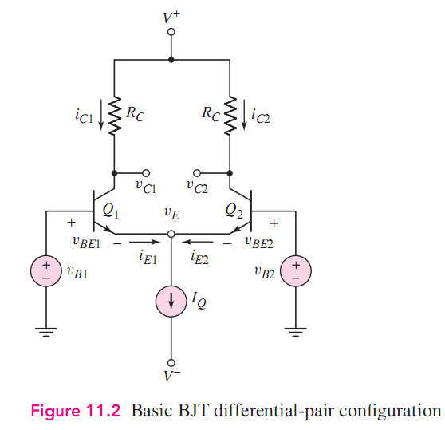
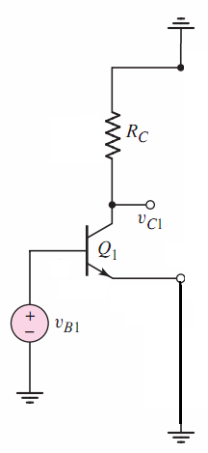

Overview
The Differential Amplifier
Single CE Amplifier

Slide 5


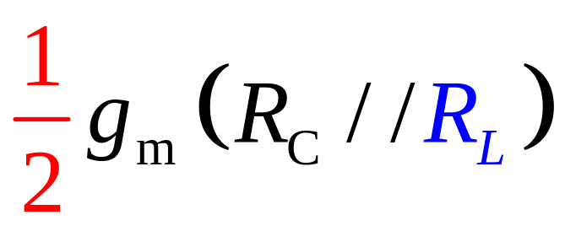
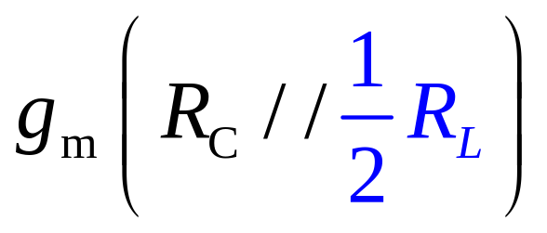

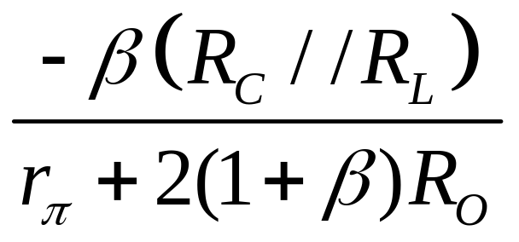


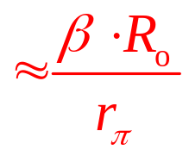




Overview

Slide 6
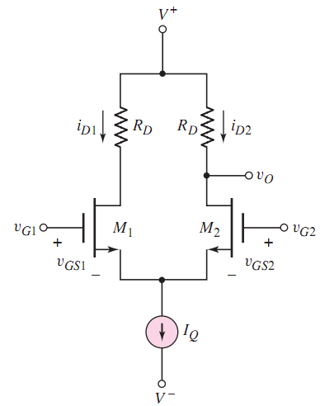
（P163）
Single CS Amplifier

Slide 7
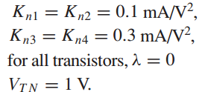
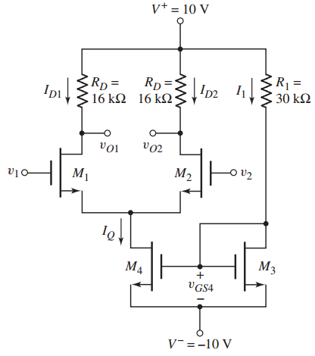
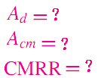

Slide 8






Slide 9







=∞

Slide 10






Slide 11
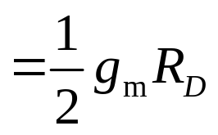


Slide 12
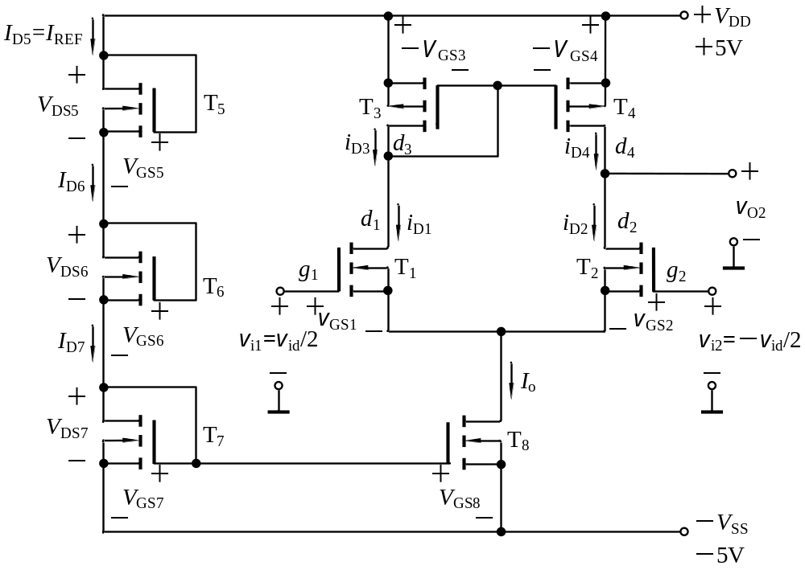

Slide 13
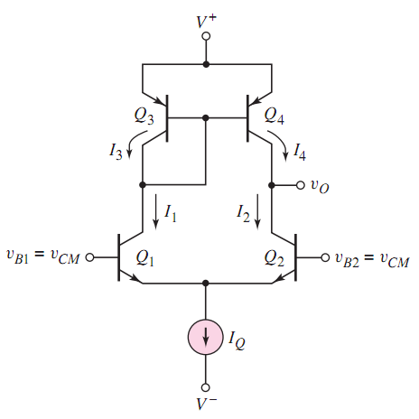

(P174)

Slide 14
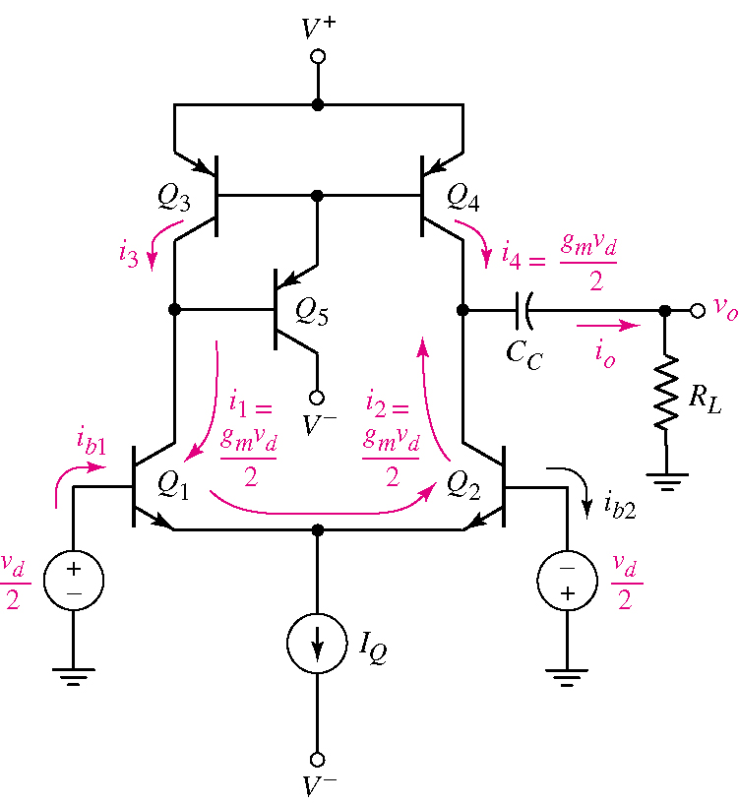
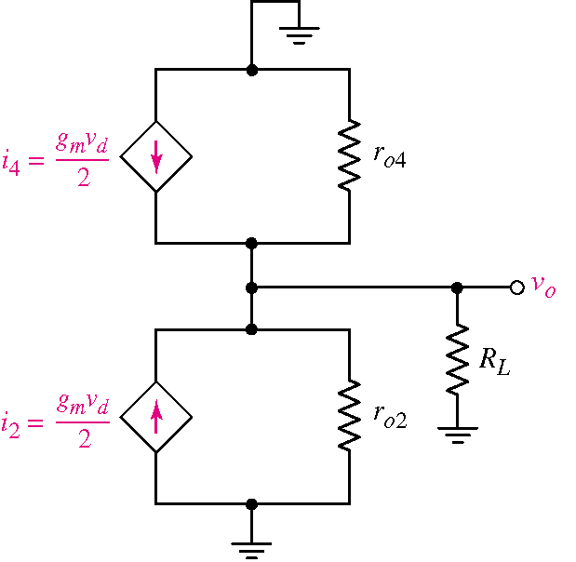
（P176）

Slide 15
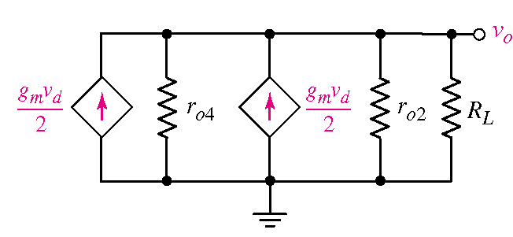
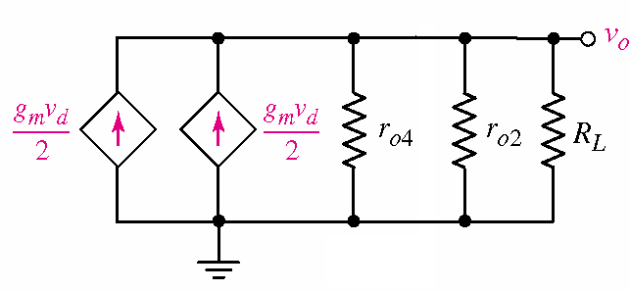


（P177）

Slide 16
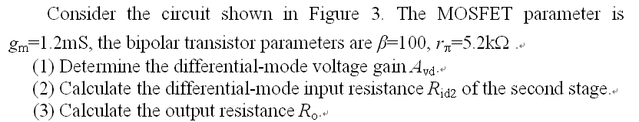
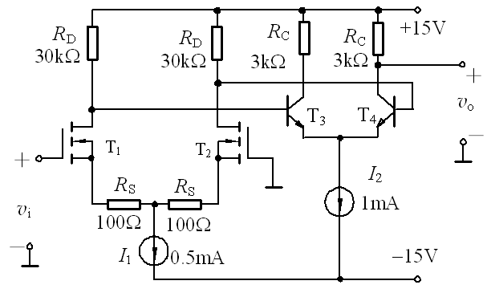

Slide 17
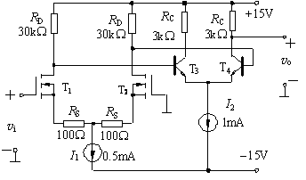
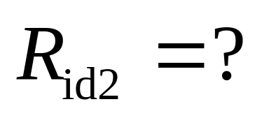
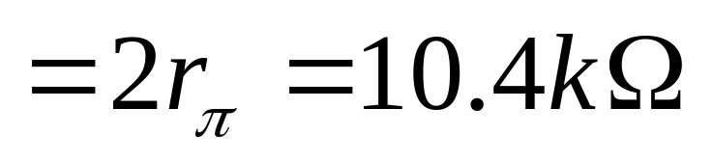

Slide 18
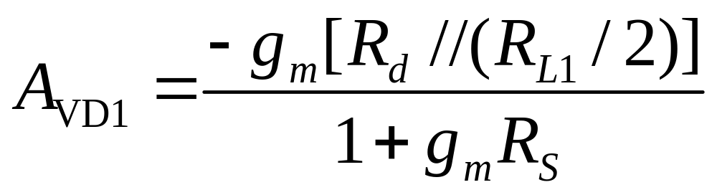
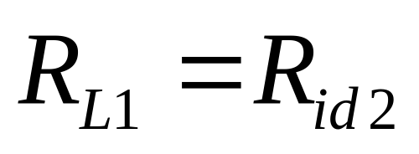

Slide 19
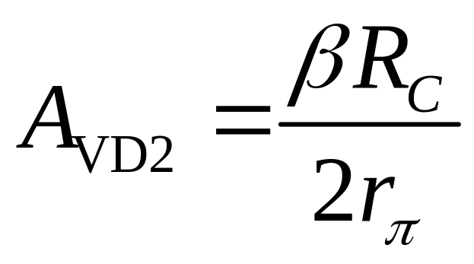
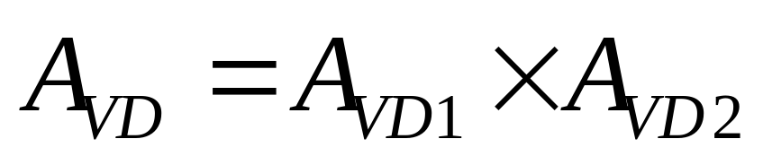

Slide 20
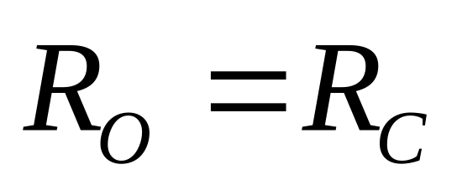

Slide 21
◆ Next, we will study ch12,
You must learn:
P233－233
245－281
285
291－295
299

Slide 22
Homework:
P209 11.3
P214 11.28

Slide 23
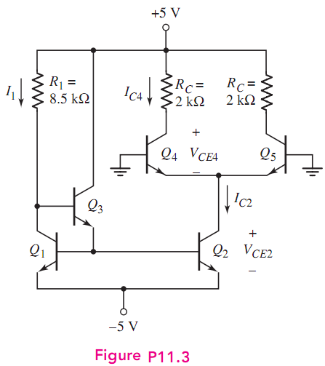

Slide 24
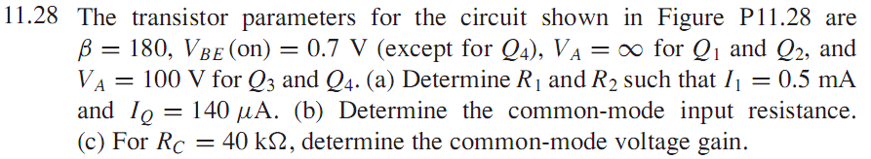
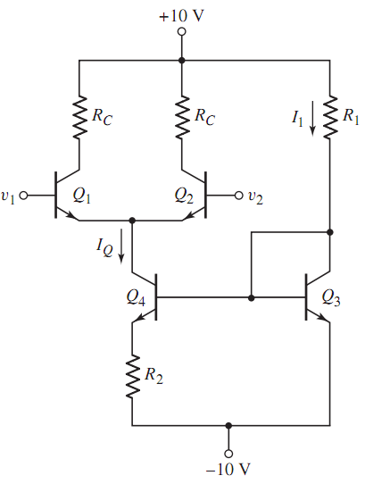

Slide 25
Questions
and
Answers

